Slide 1
ECSE 4660/6660: Internetworking of Things
Lecture 3: PHY Layer Fundamentals – Part I
Koushik Kar
ECSE, RPI
Spring 2023

Slide 2
References
V. Garg, Wireless Communications & Networking, Morgan Kauffman, 2007. (available as e-book for RPI students)
Chapter 3: Radio Propagation and Path Loss Models
Chapter 10: Antennas, Diversity, and Link Analysis
L. Couch, Digital and Analog Communication Systems, Pearson, 2012.
Chapter 1: Introduction
Chapter 8: Wire and Wireless Communication Applications
C. A. Balanis, Antenna Theory Analysis and Design, Wiley-Interscience, 2005.
Chapter 1: Antennas
Notes:
Part II is next lecture on Digital Modulation

Slide 3
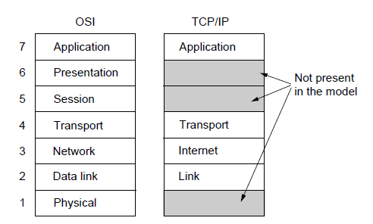
Recall: Layered Reference Model

Slide 4
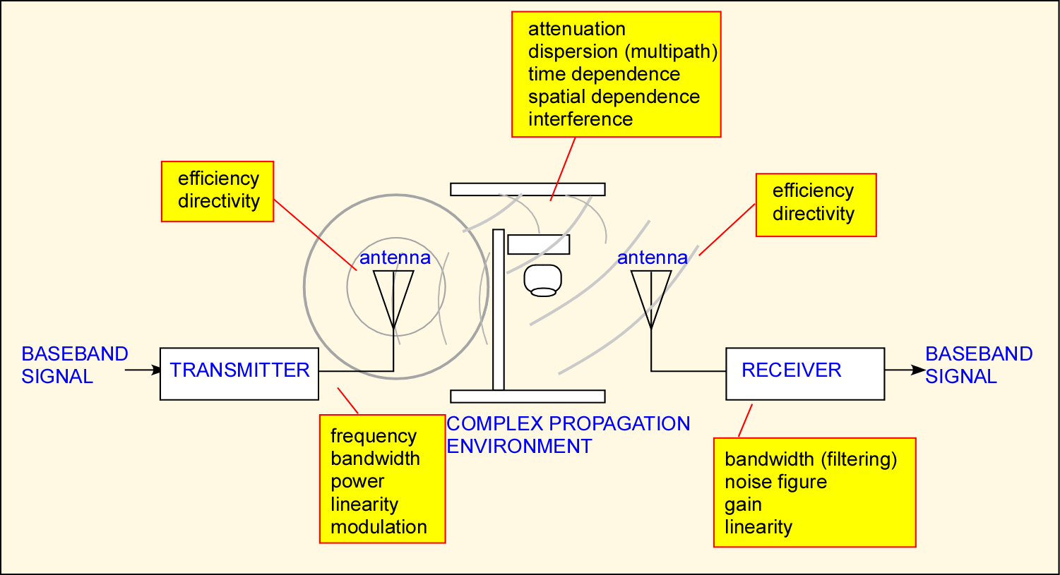
Elements of a Physical (Radio) Link

Slide 5
Topics to be covered today
Antennas
Signal propagation modes
Thermal Noise

Slide 6
Introduction
An antenna is an electrical conductor or system of conductors
Transmission – electrical energy converted to radiated electromagnetic energy into space
Reception - collects electromagnetic energy from space and converts into electrical
In two-way communication, the same antenna can be used for transmission and reception
At the same time: Full-duplex
At different times: Half-duplex

Slide 7
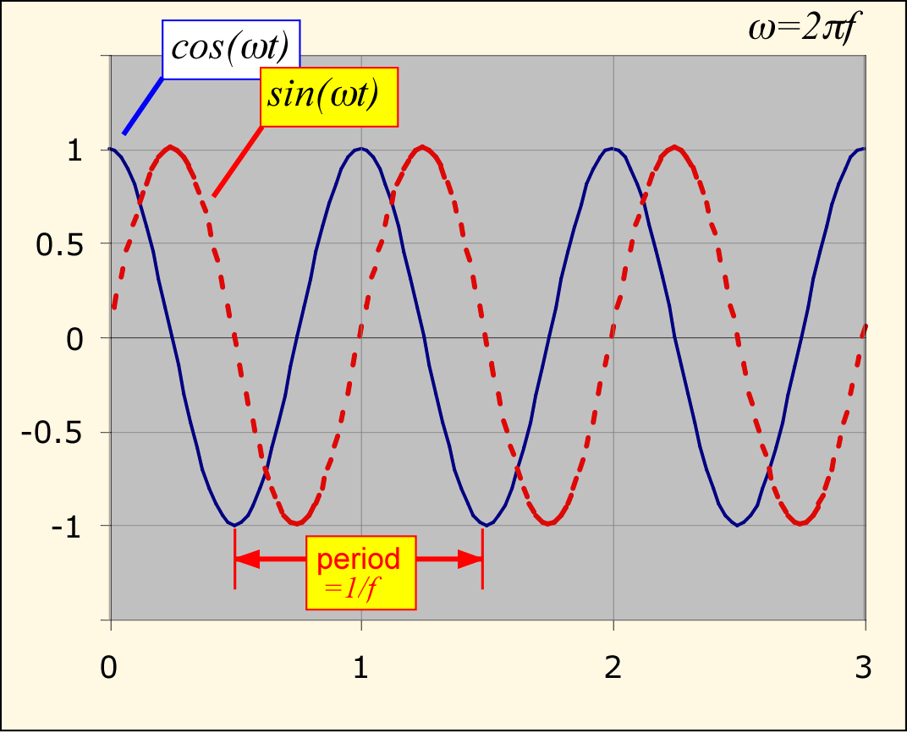
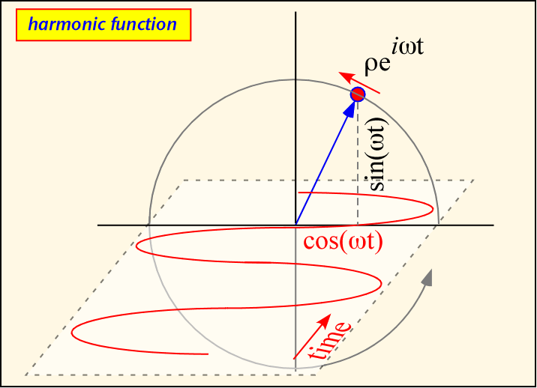
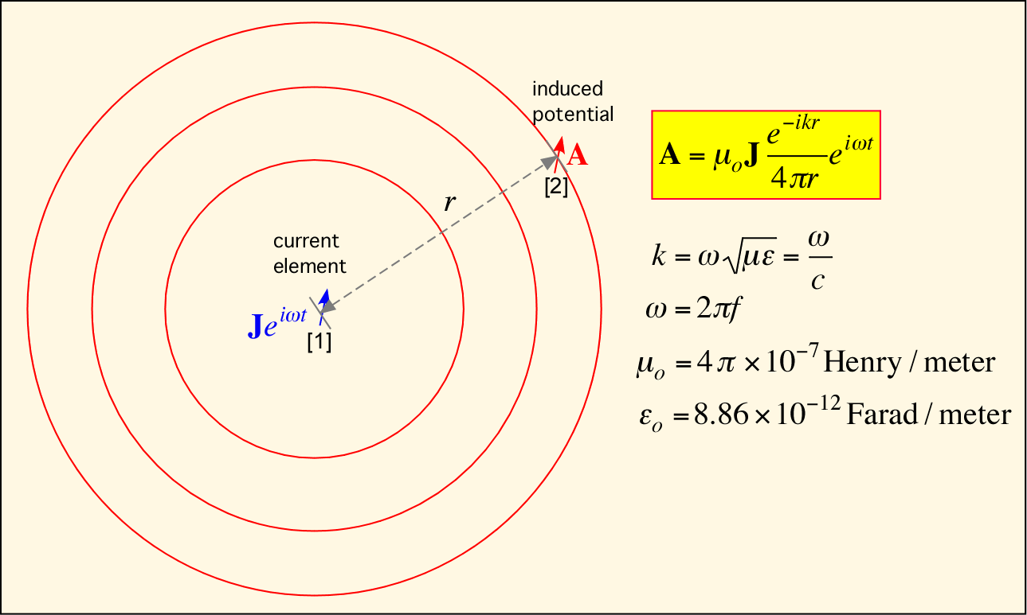
Sinusoidal Signals and Electromagnetic Waves
How is an Antenna used to communicate?
An electric current element J at some location [1] induces a potential A at other locations, e.g. [2].
If the current J[1] is harmonic in time, the induced potential A[2] is as well.
The induced potential in turn may affect the electric current J[2] at position [2].
By changing a current J[1] we create a delayed and attenuated but still detectable change in current J[2].
Thus, communication can be established by using the effects of electromagnetic disturbance.

Slide 8
Radiation
Radiation pattern
An antenna will radiate power in all directions
Typically, it does not radiate equally in all directions
The distance from the antenna to each point on the radiation pattern is proportional to the power radiated by the antenna in that direction
An ‘isotropic antenna’
is an idealized antenna, represented by a point in space that radiates power in all directions equally
Its radiation pattern is a sphere
Beam width (or half-power beam width)
Measure of directivity of antenna
Reception pattern
Receiving antenna’s equivalent to radiation pattern

Slide 9
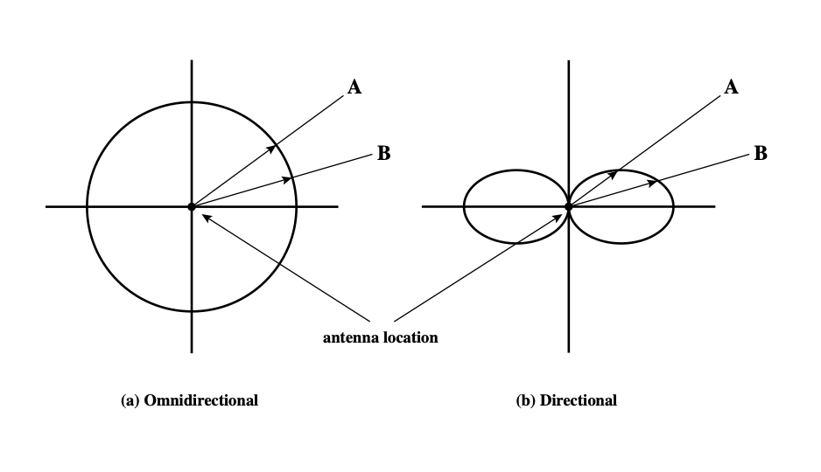
Isotropic vs Anisotropic antennas
Isotropic: omni-directional
Anisotropic: directional

Slide 10
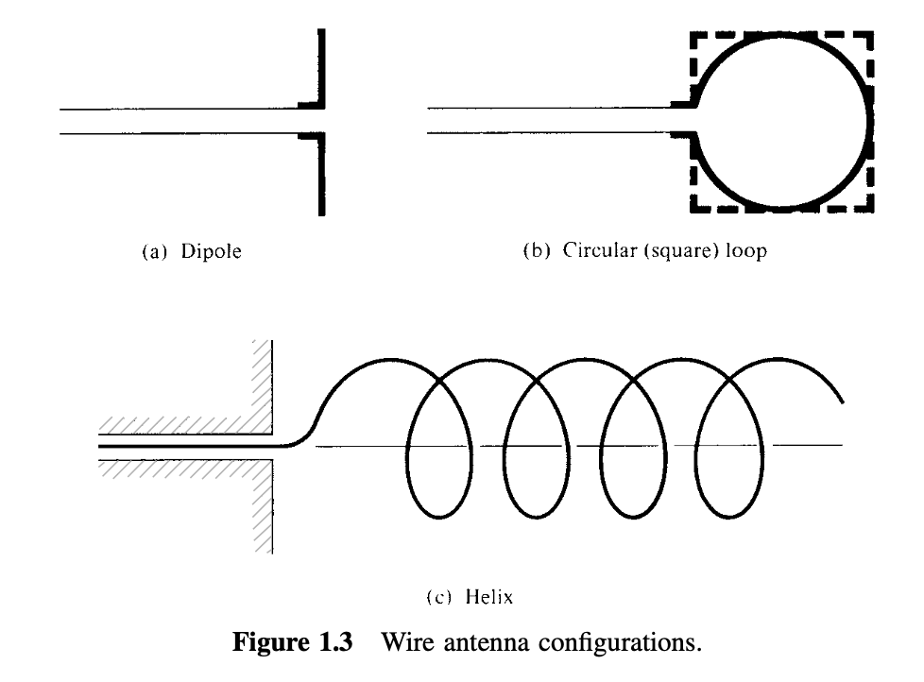
Types of Antennas
Isotropic antenna (idealized)
Radiates power equally in all directions
Wire antennas
Dipoles and Vertical Antennas
Loop antennas
Helix antennas
[Src: Chapter 1, Balanis]

Slide 11
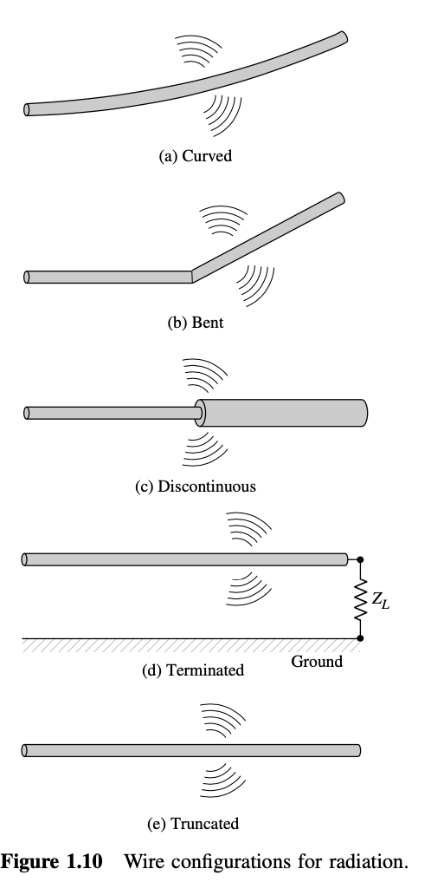
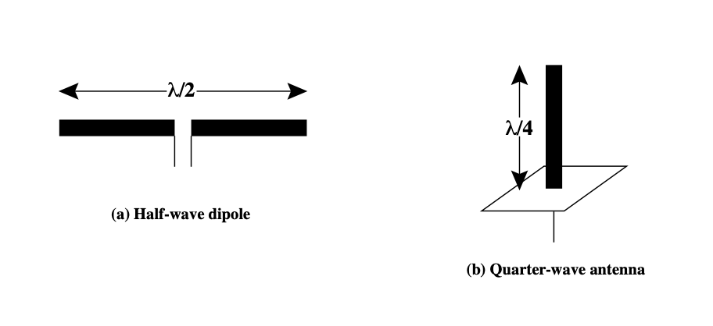
Types of Antennas (contd.)
Exact wire shape matters
Simple wire antennas
Dipole antennas
Half-wave dipole antenna (or Hertz antenna)
Vertical antennas
Quarter-wave vertical antenna (or Marconi antenna)
[Src: Chapter 1, Balanis]

Slide 12
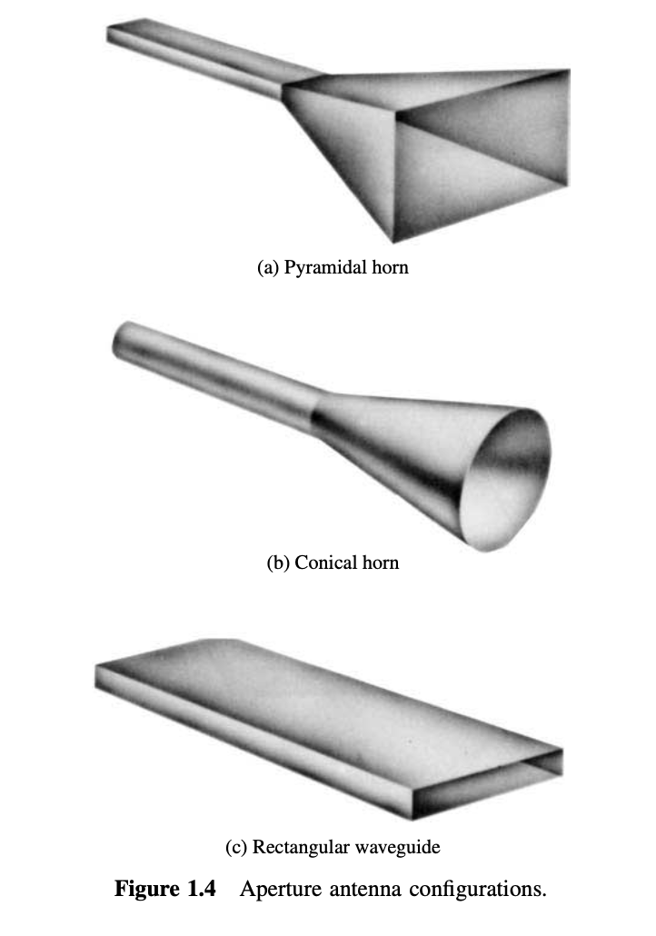
Types of Antennas (contd.)
Aperture antennas
Horn antennas
Conical antennas
Waveguides
[Src: Chapter 1, Balanis]

Slide 13
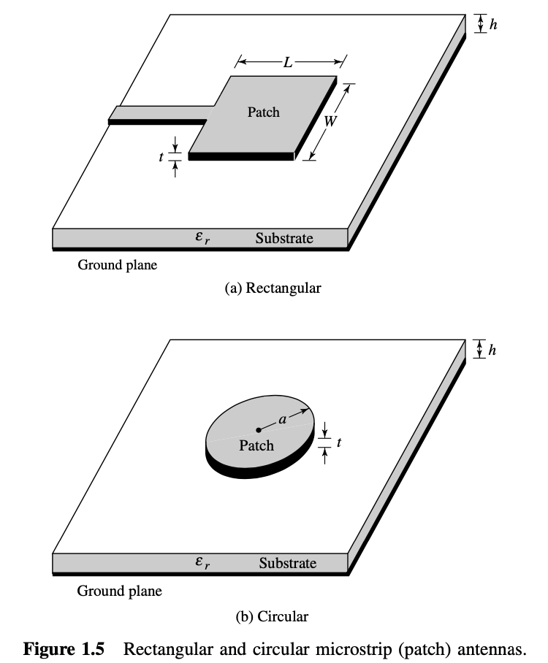
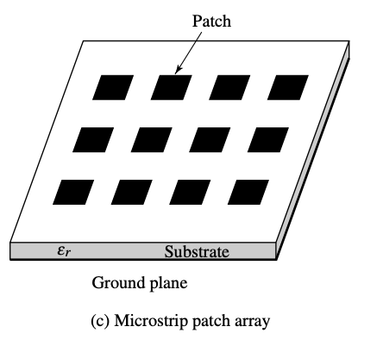
Types of Antennas (contd.)
Microstrip or patch antennas
Ideal for small devices
Small footprint
Printed into ICs
Easy to make arrays of
[Src: Chapter 1, Balanis]

Slide 14
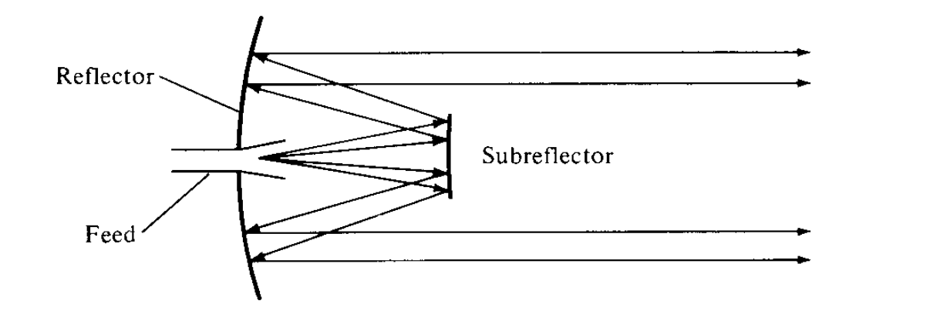
Types of Antennas (contd.)
Lens Antennas
Also called parabolic reflective antenna
[Src: Chapter 1, Balanis]

Slide 15
Antenna Gain
Antenna gain:
Power output, in a particular direction, compared to that produced in any direction by a perfect omnidirectional antenna (isotropic antenna)
The increased power in a given direction is at the expense of other directions
Refers to directionality, i.e. relative amplification in a certain direction
Effective area
Related to physical size and shape of antenna

Slide 16
Antenna Gain (Cont’d)
Relationship between antenna gain and effective area
G = antenna gain
A_{e} = effective area
f = carrier frequency
c = speed of light (= 3 x 10⁸ m/s)
= carrier wavelength
Note:

Slide 17
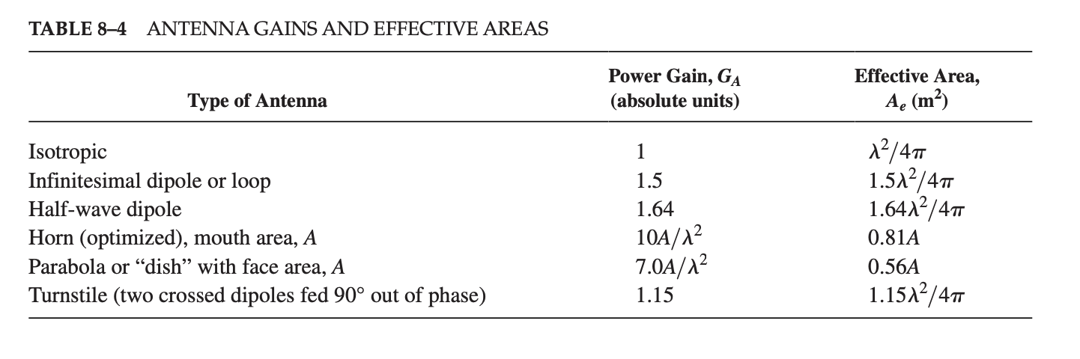
Antenna Gains and Effective Areas
[Src: Chapter 8, Couch]

Slide 18

Example
Q: A parabolic reflective antenna with a diameter of 2m operating at 12 GHz. Find the antenna gain.
G = antenna gain
A_{e} = effective area
f = carrier frequency
c = speed of light (= 3 x 10⁸ m/s)
= carrier wavelength
Notes:
A = pi r^2 = pi
A_e = (from table) 0.56A = 0.56 pi
lambda = c/f = 3 x 10^8 / (12 x 10^9) = 0.025 m.
G = 7A / lambda^2 = 7 pi / (0.025)^2 = 35,186
G_{dB} = 45.46 dB

